Slide 1
Overlay Networks
Xin Jin
Fall 2017 (TTh 1:30-2:45 in Malone 228）
EN.601.714 Advanced Computer Networks
https://github.com/xinjin/course-adv-net
Notes:
Slides adapted from Princeton COS 561 Advanced Computer Networks

Slide 2
The Start:
Sean Parker
File-sharing service for music
Launched in June 1999
Had tens of millions of users in one year
Revolutionized the music industry, precursor of iTunes

Slide 3
The Facebook -> Facebook
The Social Network

Slide 4
Now the papers…

Slide 5
Overlay Networks -> Today?
Major challenge: scalability (routing)
Scale: millions of nodes
Constraint: limited resource to host routing tables
Does this still apply to today’s scenario?
1 thousand nodes * 4 bytes/node = 4 KB
1 million nodes * 4 bytes/node = 4 MB
1 billion nodes * 4 bytes/node = 4 GB
Useful properties: scalability (storage), load balance, fault-tolerance

Slide 6
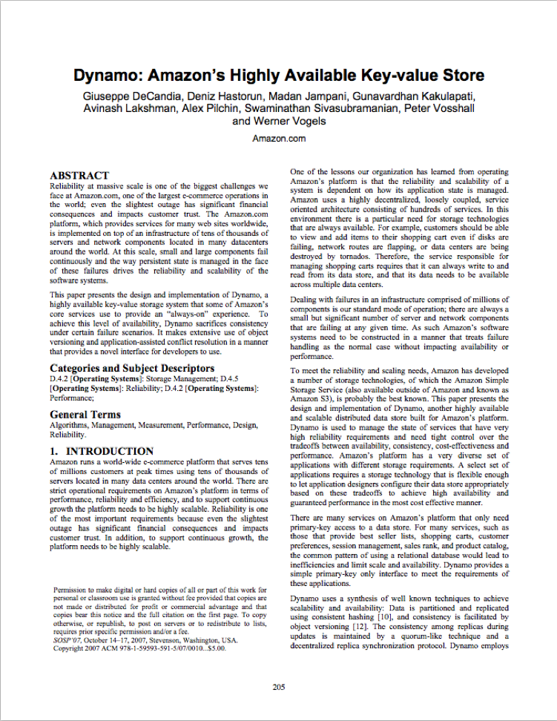
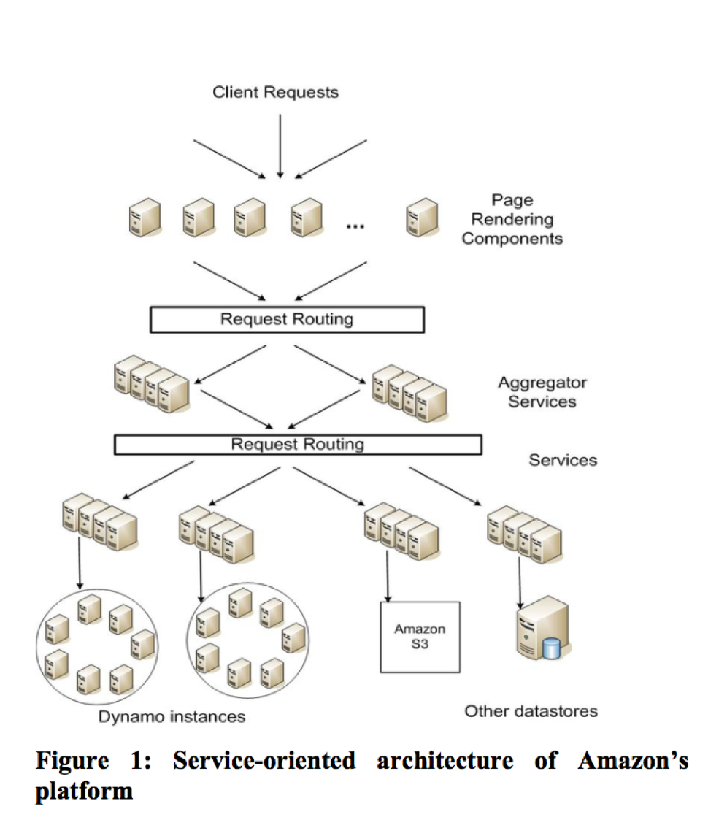
Past: Overlay Networks -> Today: Distributed Storage

Slide 7
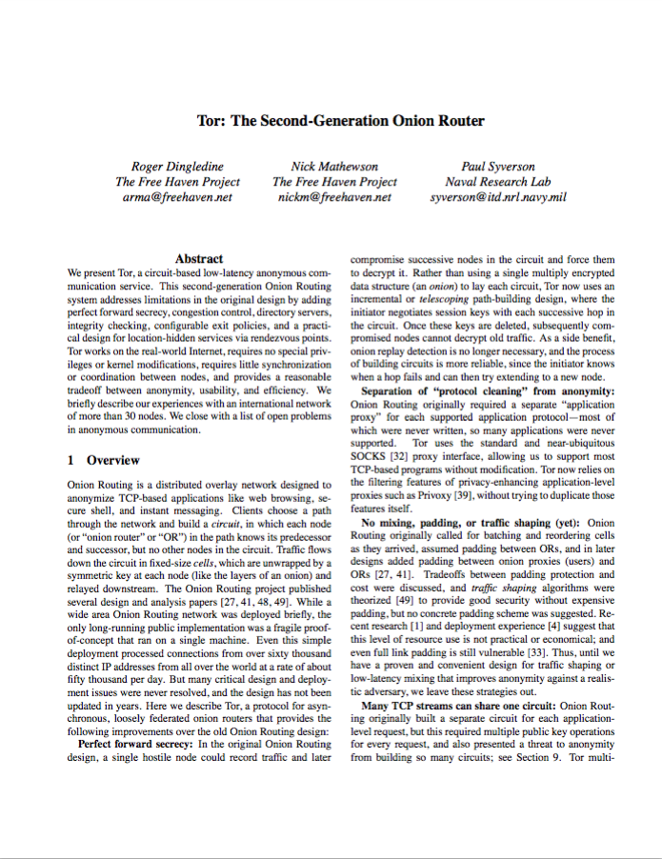
Past: Overlay Networks -> Today: Anonymous Networks

Slide 16
Thanks! Q&A

